Slide 1
STAFF COMPLACENCY
The Leadership Blindspot That Demands Attention
Notes:
KM + AG

Slide 2
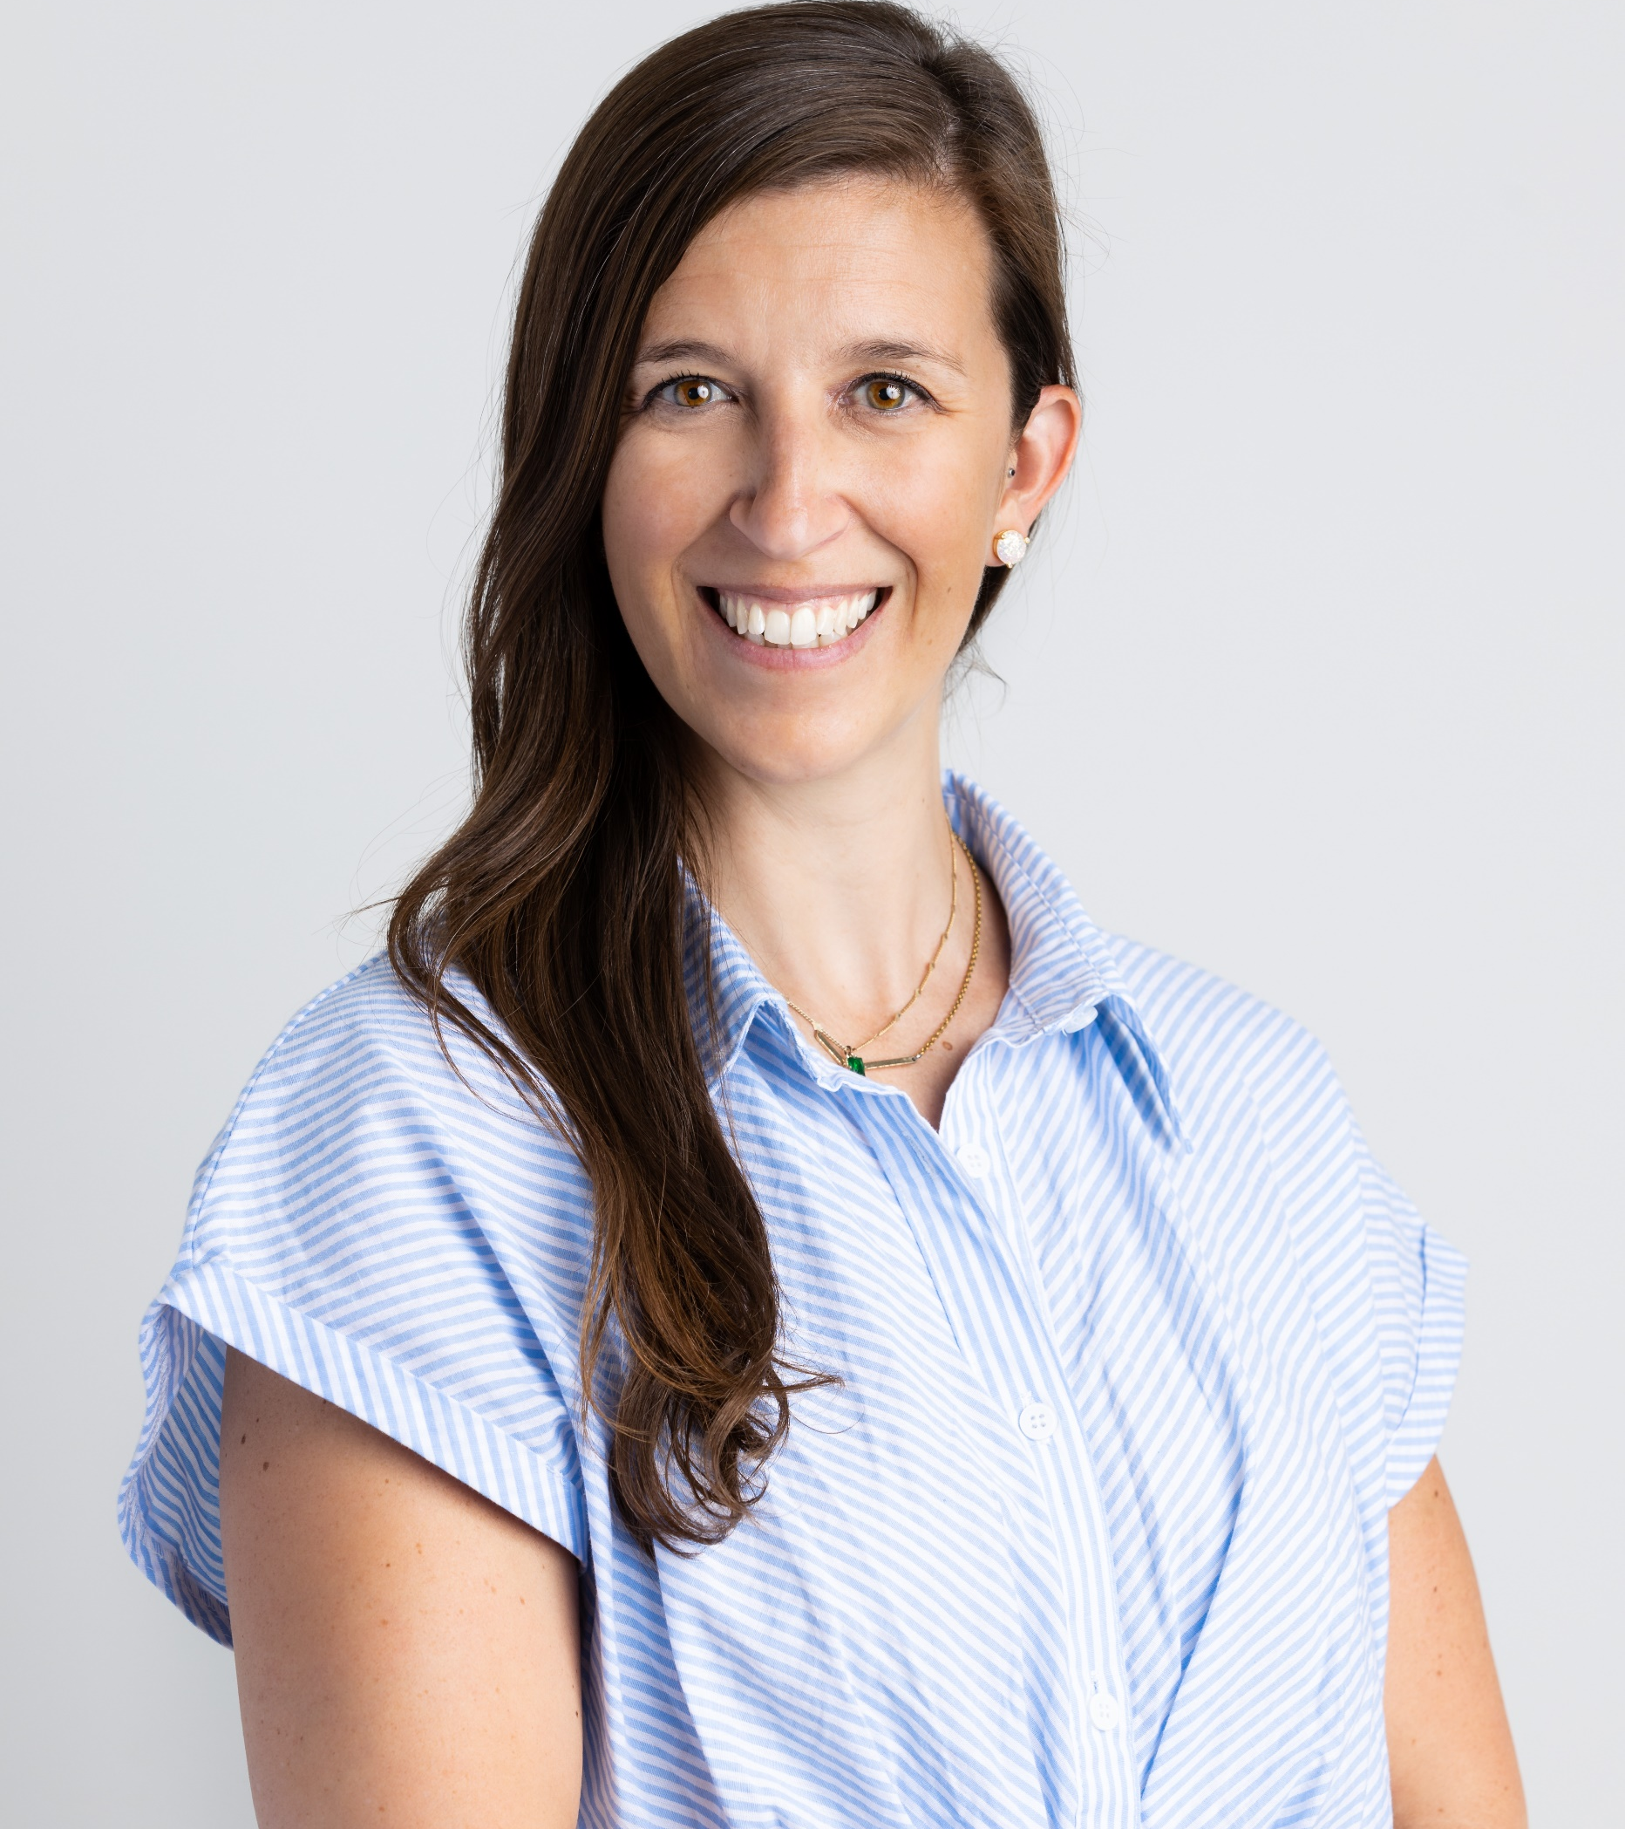
WHO ARE WE?
Karine Mayers
Fund Development Director, Quebec
Leukemia and Lymphoma Society of Canada
Alexis Gaiptman, MBA CFRE
Vice-President, Quebec
Make-a-Wish Canada

Slide 3
How about you?

Slide 4
Goals today
Organizational Barriers
Change & Happiness
Knowledge Sharing

Slide 5
Agenda
Definition of complacency
Causes of complacency
Consequences of complacency
Organizational Barriers
Organizational culture
10 Take-a-ways
Conclusion

Slide 6
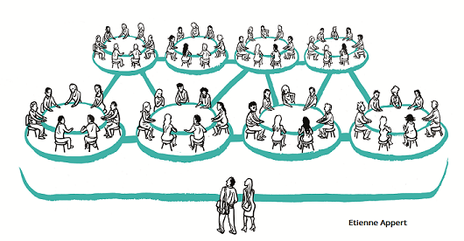
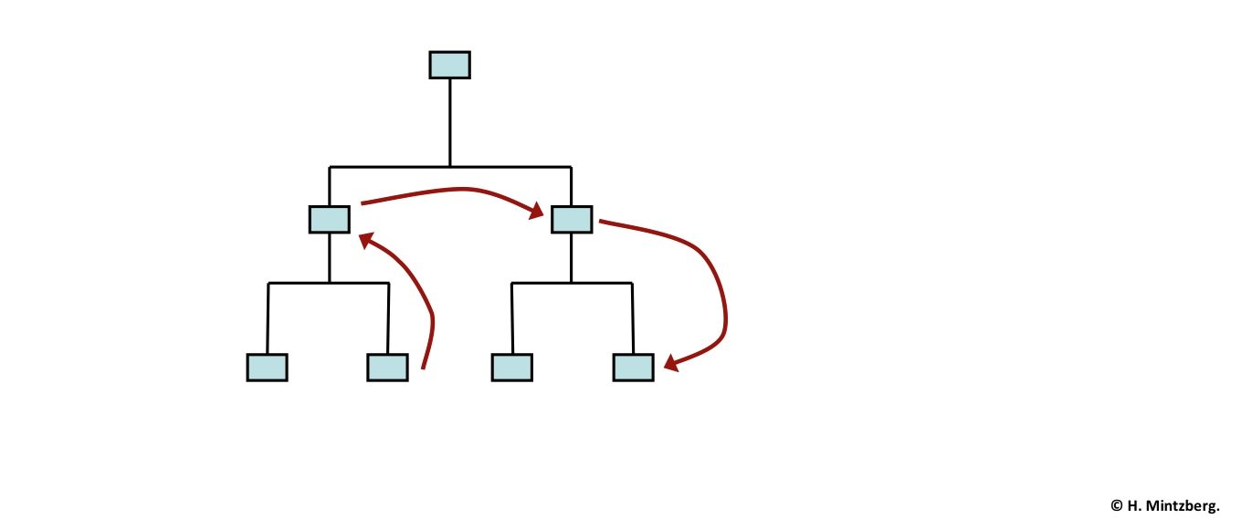
The Power to Reorganize

Slide 7
Does this look familiar?

Slide 9
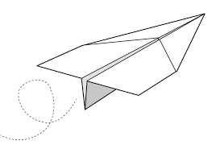
Why is this topic important?

Slide 10
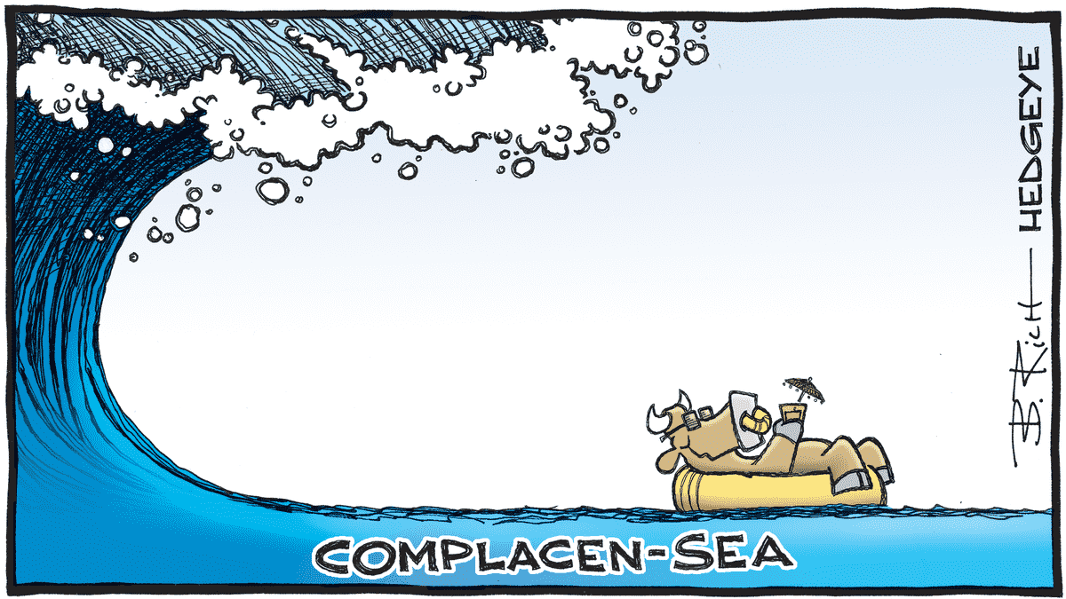
CONTEXTUALIZE THE PROBLEM
Workplace complacency means:
settling for “good enough,” while influential organizations adopt a “what’s next?” mentality.”

Slide 11
CAUSES OF COMPLACENCY

Slide 12
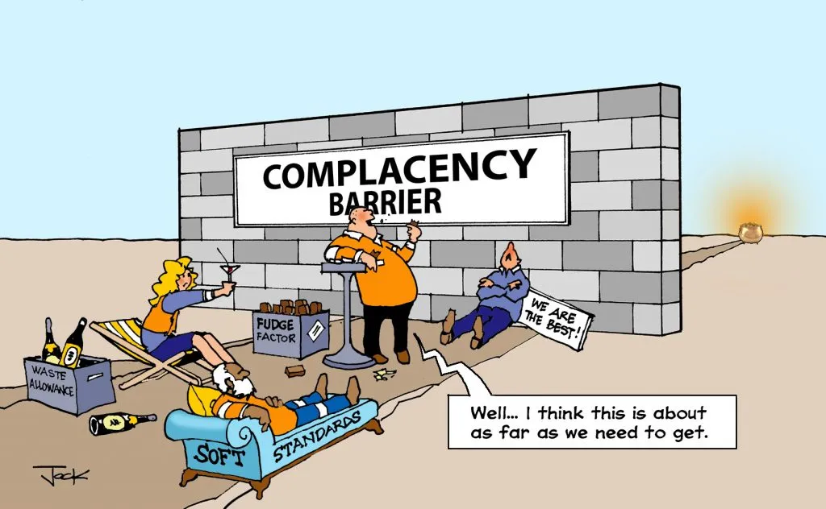
Absence of Accountability & Low Standards

Slide 13
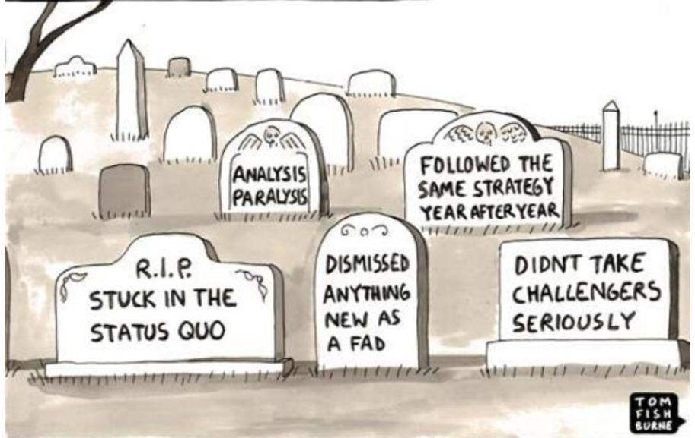
Lack of Autonomy & Overconfidence

Slide 14
Slow Growth

Slide 15
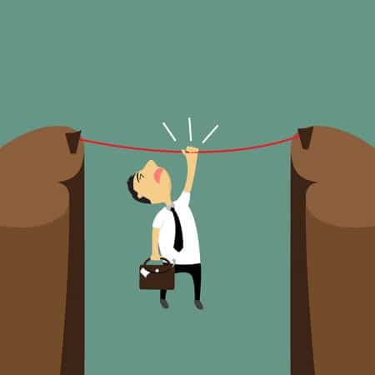
Excuses
Shortcuts

Slide 16
Strict adherence to rules
Silence

Slide 17
Playing it Safe

Slide 18
PLANNING FOR CHANGE
“Organizational change is inevitable. Don't let complacency stand in your way!”
-Brent Gleeson

Slide 19
Barrier 1
Communication and knowledge sharing

Slide 20
Barrier 2
Performance metrics

Slide 21
Barrier 3
Technology and location

Slide 22
Culture eats strategy

Slide 23
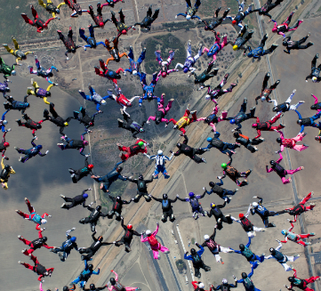
Take-a-ways
Knowledge share
Mission
Professional development
Goals
External stakeholders
Rethink
Time
Performance reviews
Team and culture building
Updates

Slide 24
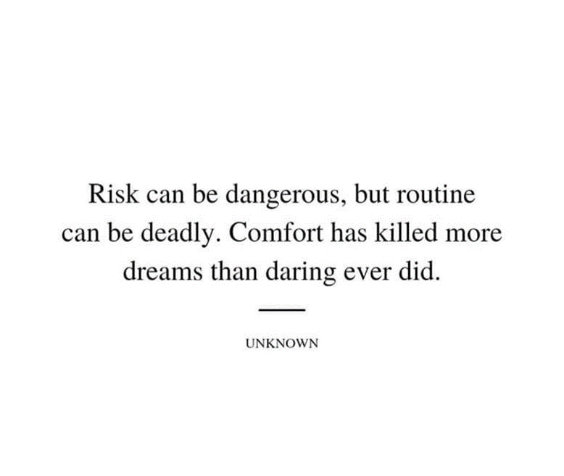
Conclusion

